Slide 1
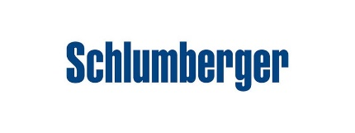
Client: DNO Norge AS Rig : Borgland Dolphin Well : 1/3 – A – 1H Date : 20-Jul-21
IBCS-E Sub Lost in the Well Incident

Slide 2
Situation Description:
During the rig down of the Wireline IBC-CBL Run on the 13 3/8” Casing, the tools were being pulled by the rig tugger.
The tugger chain had an angle in relation to the well, this causing that the wireline tools were tilted while rigging up and down.
Due to the size of the rotating sub (IBCS-E OD: 10.33in) half of the bowl on the RT was taken out to create clearance.
The rig tugger doesn’t have any tension indicator, High tension alarm or shut down.

Slide 3
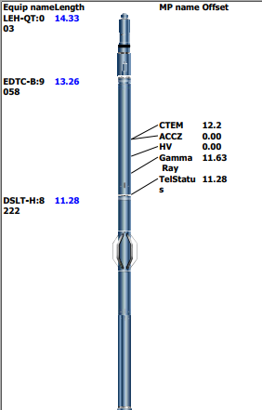
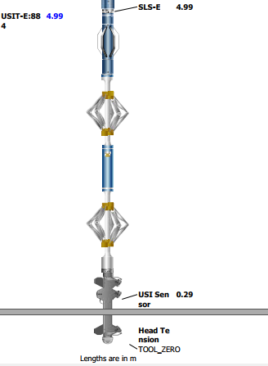
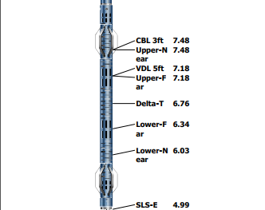
Wireline BHA: EDTC – DSLT – USIT_IBC Length: 14.33m Max OD: 10.33 in
Rotating Sub IBCS-E

Slide 4
Incident Description
During the rig down of the Wireline toolstring, tools had to be pushed by hand due to the angle between the tugger and the well.
While pulling out the bottom tool, the rotating sub (IBC-E) at the end of USIT got stuck against the rotary table.
Since there was no tension indicator on the tugger, the crew continued to pull without noticing that the sub was getting pulled apart.
Finally the sub broke and fell into the well.

Slide 5
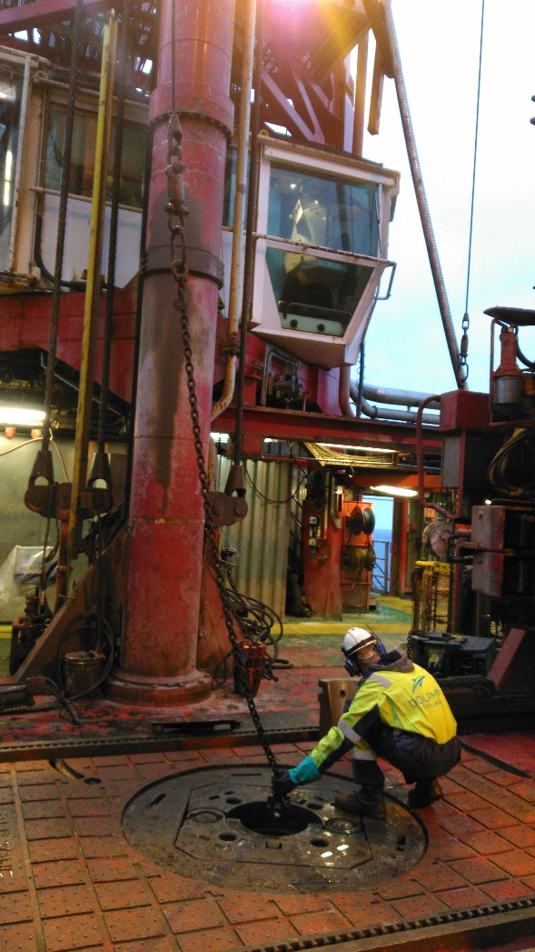
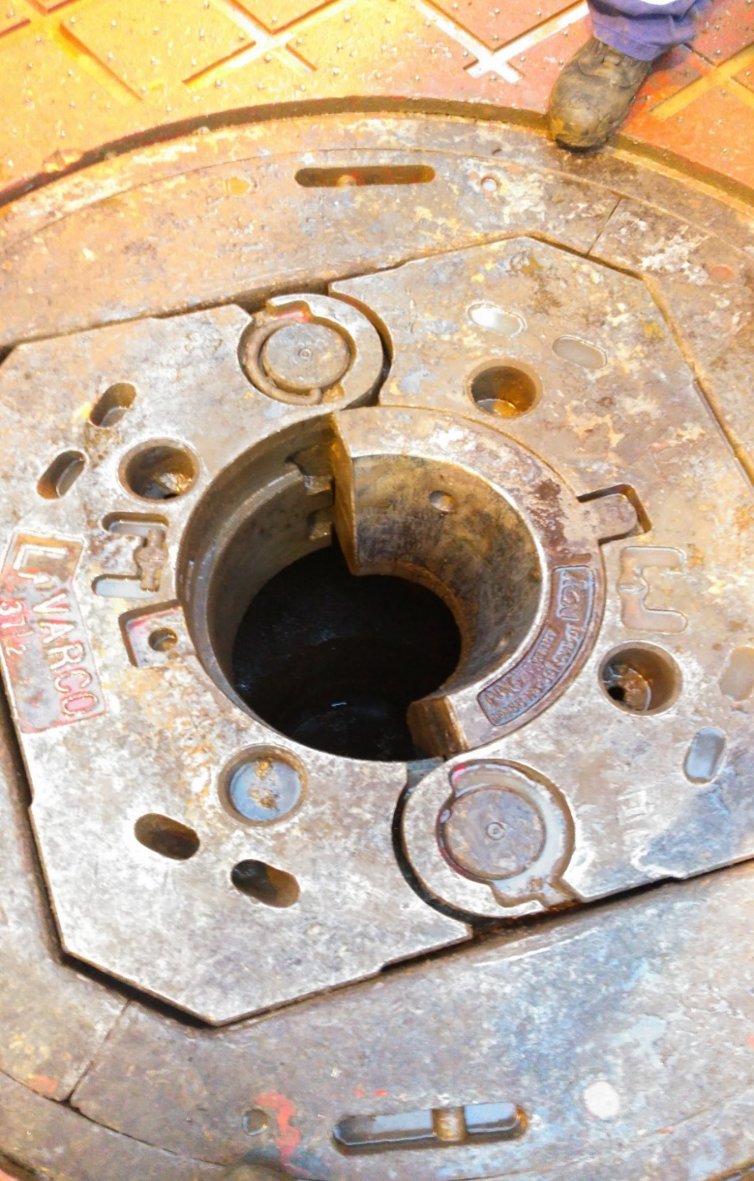
Angle between chain and well
Half of the bowl removed to create clearance

Slide 6
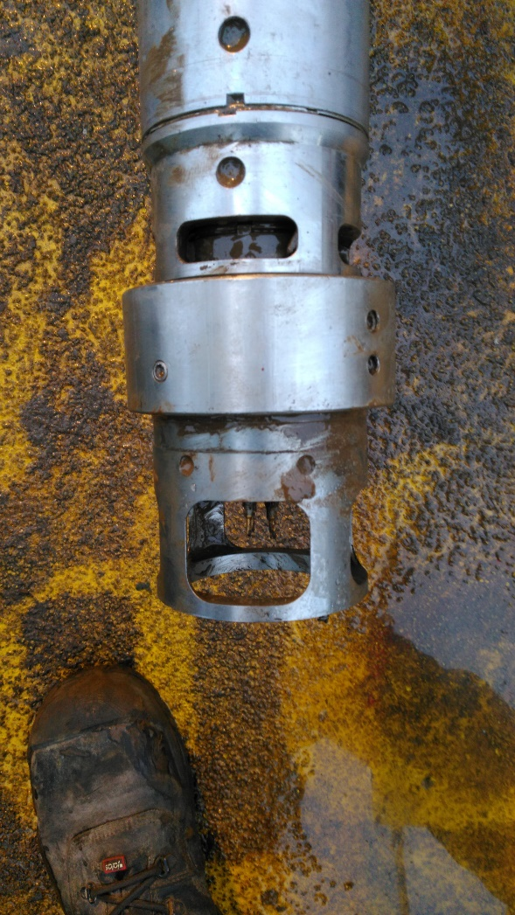
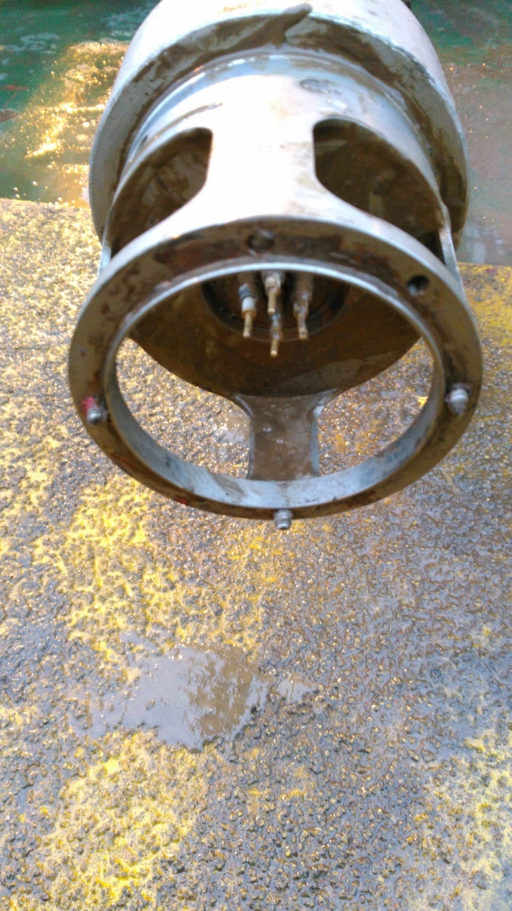
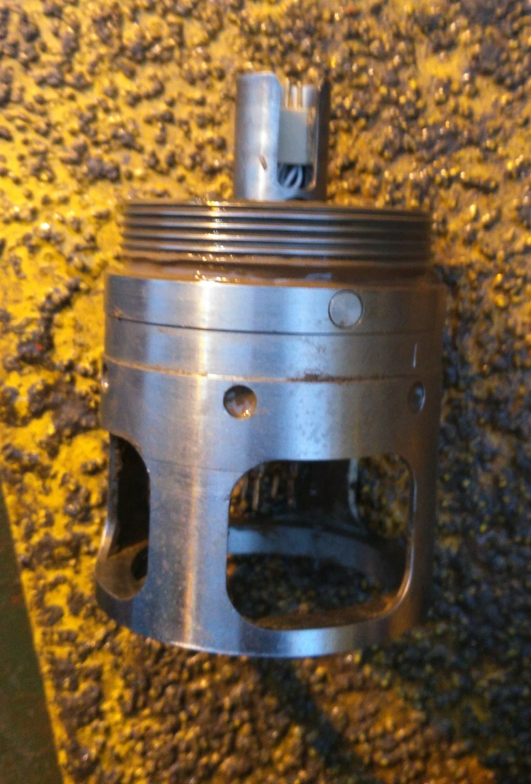
Bottom of USIT after Rig Down, with remaining piece of Rotating Sub
Severed Bolts
Bottom of USIT with top
of IBC-E attached
Top of rotating sub (IBC-E)
(last remaining part)

Slide 7
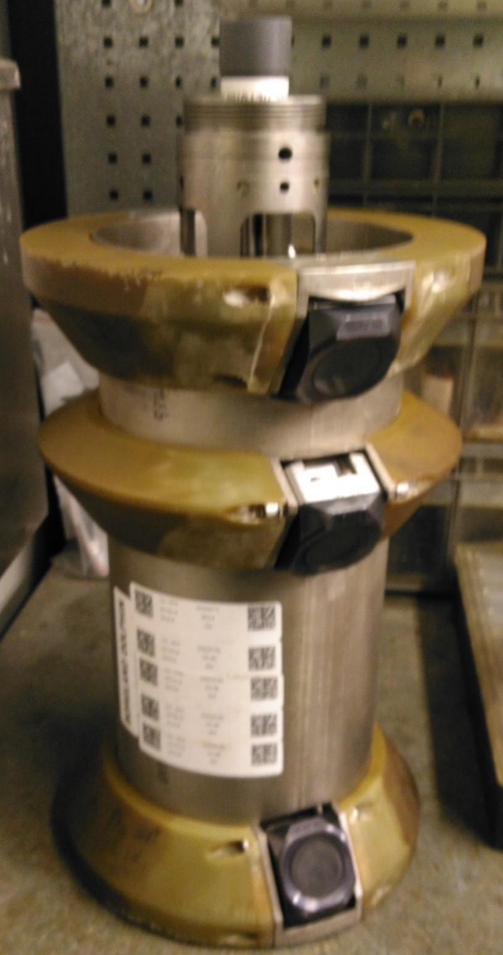
Rotating Sub IBCS - E:
Length: 532 mm (29.95 in)
OD : 262,4 mm (10.33 in)
Non Magnetic

Slide 8
Mitigating Measures
Re-emphasise the following items at the TBT:
Risk of snagging toolstring at rotary table while being recovered on tugger line.
Discuss tugger alignment. Tugger is not aligned over the well and the toolstring will be pulled to the side.
Remove both rotary table bowl inserts prior to handling larger OD sections of toolstring such as Ultrasonic sub.
SLB wireline rig book for Borgland Dolphin to be updated with this learning.
SLB to review and distribute internally.

