Slide 1
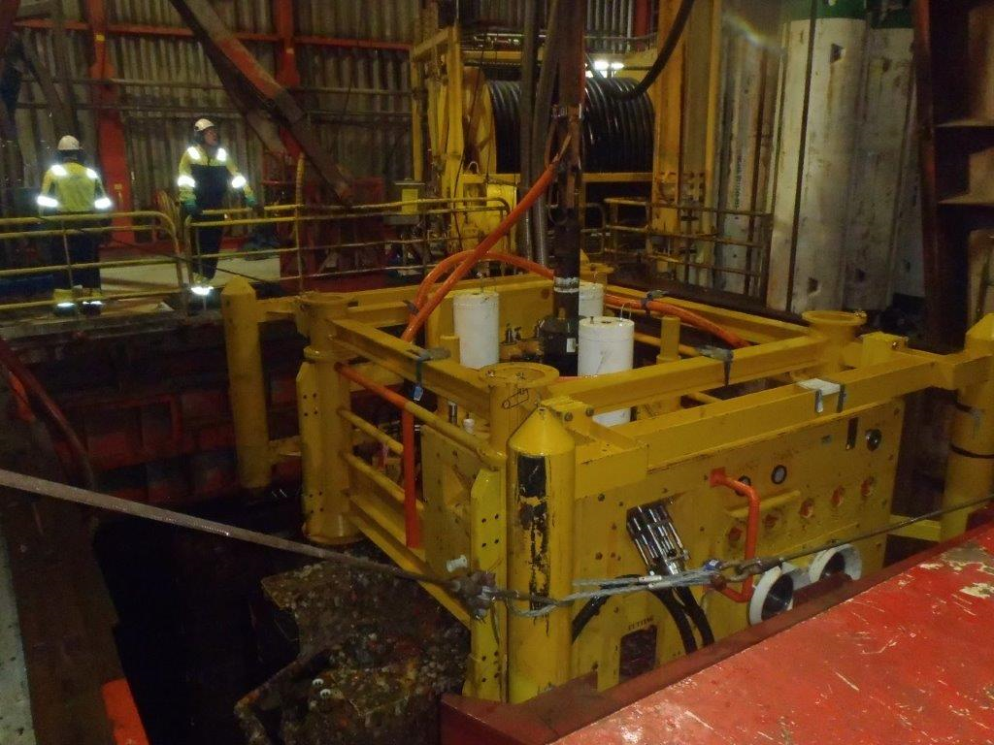
TRT in UHG system with tuggers on TRT for over hull guidance
TRT not engaged with port UHG – conflict with HXT hub
TRT laying against starboard UHG only and rig trimmed starboard
SCM pointing aft on recovery

Slide 2
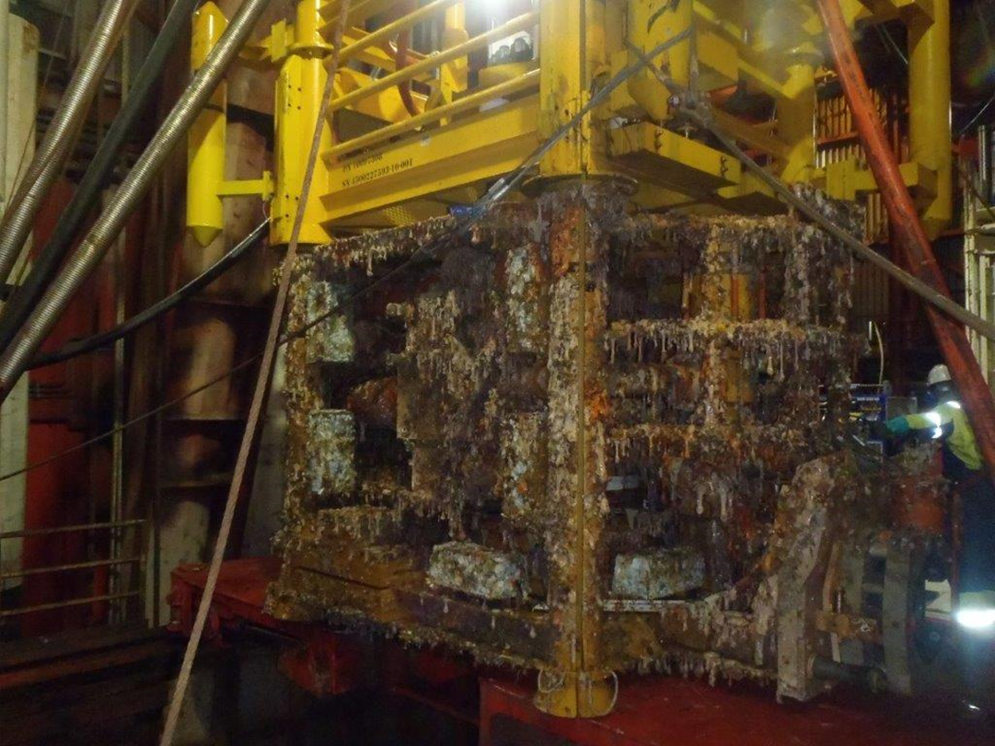
TRT/HXT on 105 ton skid after 90° CCW turn
SCM (out of shot) now pointing to starboard – towards BOP
Hub now rotated from port to aft

Slide 3
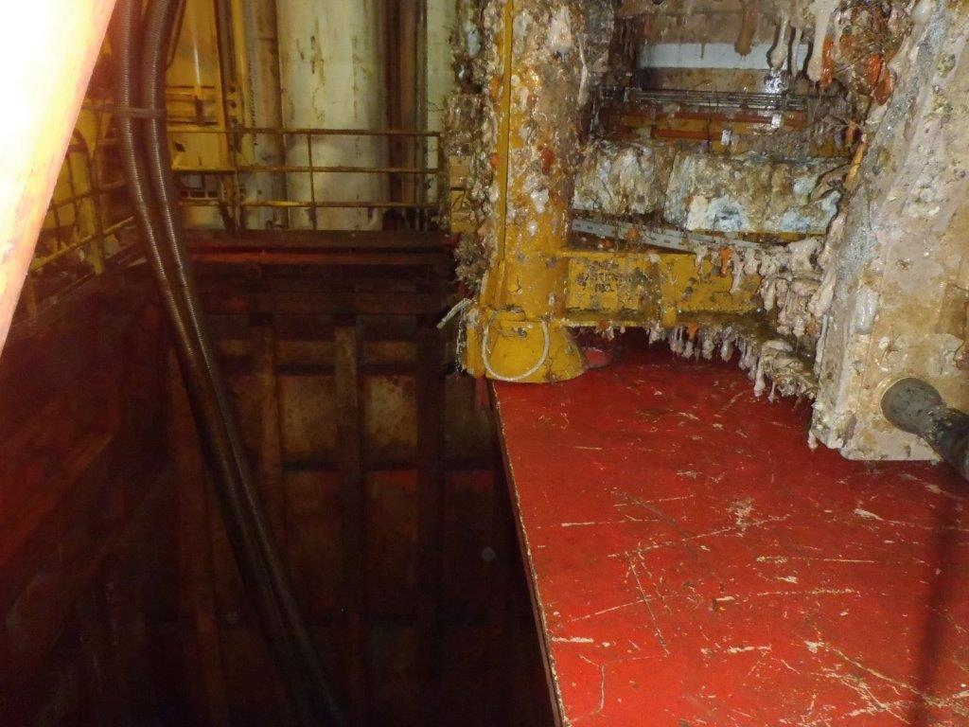
HXT funnel position on 105 ton skid (port side)
Hole for mini-post

Slide 4
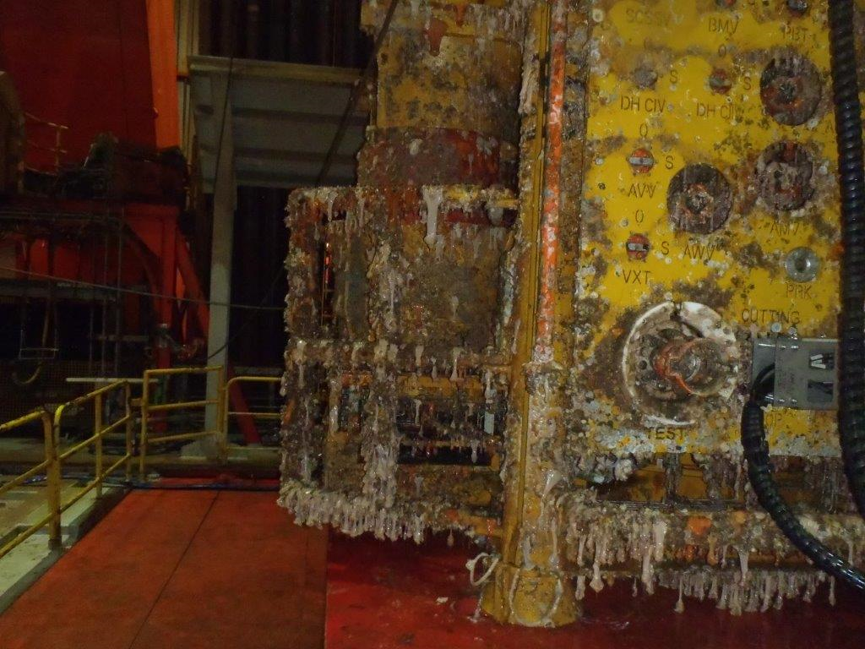
Overhang of SCM vs starboard edge of 105 ton skid
Hole for mini-post

Slide 5
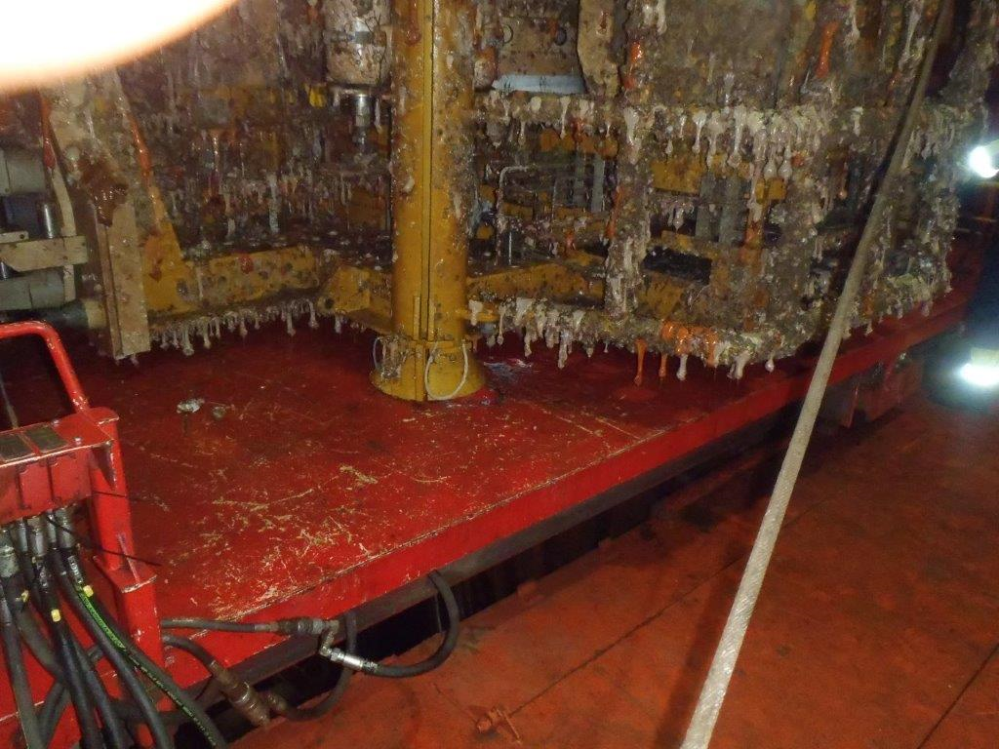
HXT funnel position vs holes for mini-posts on 105 ton skid (starboard side)
± 20 cm center to center

Slide 6
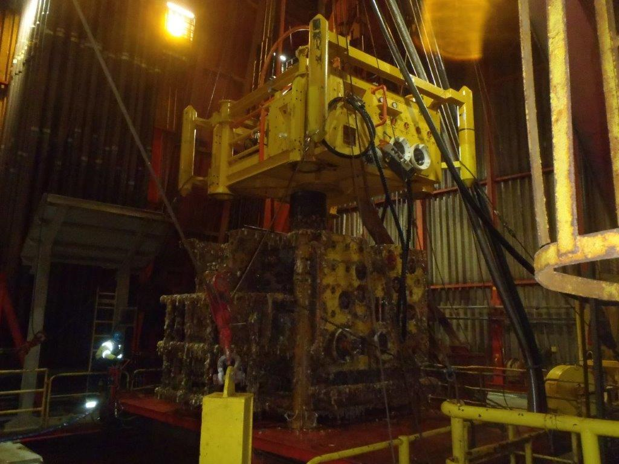
TRT released from HXT
SCM to starboard (towards BOP)

Slide 7
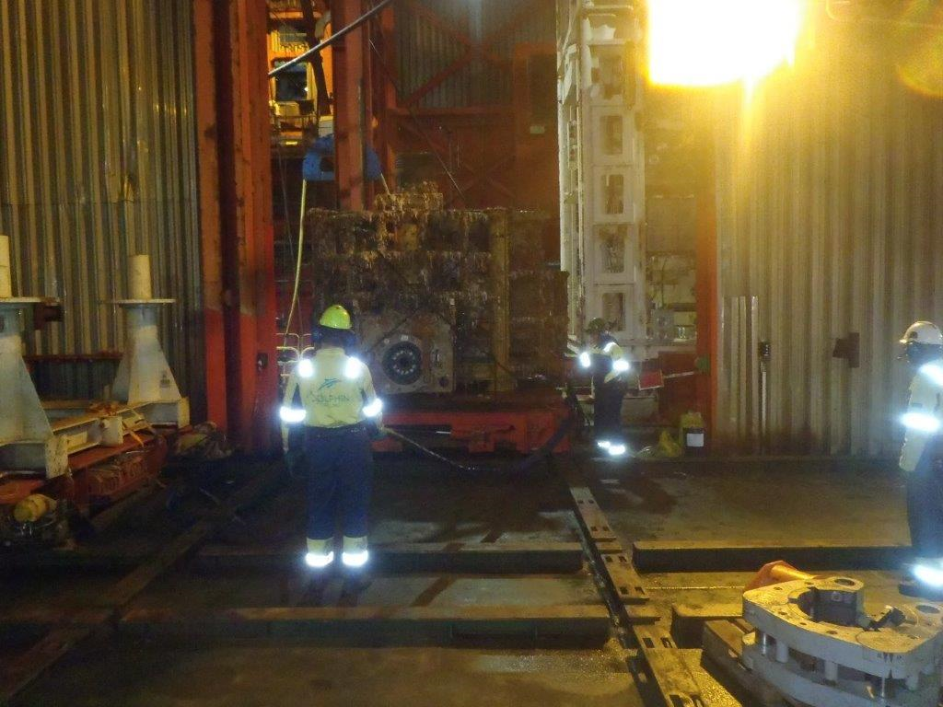
HXT skidding out through cellar deck door
32 cm from SCM bumper bar to BOP
Obs:
If mini-posts used to land on this clearance would be 10-12 cm

Slide 8
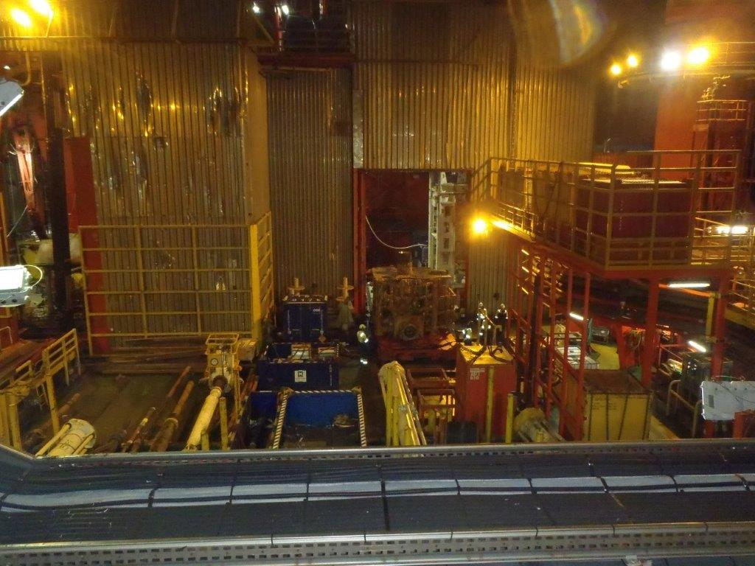
HXT skidding out onto main deck

